Slide 1
SWE 4101
Computer Architecture
&
Software Concepts
Lec - 4
Based on: Books and various web resources…

Slide 2
Computer Architecture
Just as buildings, each computer has a visible structure, referred to as its architecture.
In computer science and engineering computer architecture is the practical art of selecting and interconnecting hardware components to create computers that meet functional, performance and cost goals and the formal modeling of those systems.
The functional blocks in a computer are of four types:
  1. Central Processing Unit
  2. Memory
  3. Input Unit
  4. Output Unit

Slide 3
Data flow between cpu, memory and i/o devices
Data Path
Control Signals
Auxilliary Storage
(Backing Storage)
To Supplement main storage
Memory
Input Unit
Output Unit
Control Unit
ALU
Registers
Processor

Slide 4
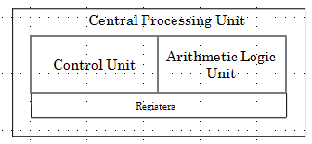
Central Processing Unit (CPU)
The CPU or the microprocessor (or simply processor) is referred as the brain of a computer system.
CPU consists of three main subsystems, the Control Unit (CU), the Arithmetic Logic Unit (ALU), and the Registers.
Speed of the computer system is defined by the architecture of the processor being used.
Processor architecture decides things like:
1. Clock Speed (GHz)
How many operations the CPU can do per second.
Higher GHz usually → faster performance.
2. Number of Cores
More cores → can handle more tasks at the same time.
3. Instruction Set
This is the “language” the CPU understands (like x86, ARM).
Efficient instruction sets → faster execution of programs.
4. Cache Memory
Small, super-fast memory inside the CPU.
Larger cache → CPU spends less time waiting → faster performance.
5. Pipeline & Execution Units
Modern CPUs can break tasks into smaller steps and run them in parallel.
Better pipeline design → higher speed.

Slide 5
Arithmetic Logic unit
Operations are executed in the Arithmetic and Logic Unit (ALU).
  Arithmetic operations such as addition, subtraction.
  Logic operations such as comparison of numbers.
In order to execute an instruction, operands need to be brought into the ALU from the memory.
  Operands are stored in general-purpose registers available in the ALU.
  Access times of general-purpose registers are faster than the cache.
Results of the operations are stored back in the memory or retained in the processor for immediate use.

Slide 6
Communication inside a computer..
A computer program consists of both instructions and data. The program is fed into the computer through the input unit and stored in the memory.
In order to execute the program, the instructions have to be fetched from memory one by one.
This fetching of instructions is done by the control unit.
After an instruction is fetched, the control unit decodes the instruction.
According to the instruction, the control unit issues control signals to other units.
After an instruction is executed, the result of the instruction is stored in memory or stored temporarily in the control unit or ALU, so that this can be used by the next instruction.
The results of a program are taken out of the computer through the output unit.
The control unit, ALU and registers are collectively known as Central Processing Unit (CPU)

Slide 7
INTERCONNECTIONS of UNITS..
Set of wires used for interconnection is known as system bus which carry group of bits (information) in a controlled manner.
It is further divided into three logical units, namely the address bus, the data bus, and the control bus.
The uppermost bus is the address bus. When the CPU reads data or instructions from or writes data to memory, it must specify the address of the memory location it wishes to access.
Data is transferred via the data bus. When CPU fetches data from memory it first outputs the memory address on to its address bus. Then memory outputs the data onto the data bus. Memory then reads and stores the data at the proper locations.
Control bus carries the control signal. Control signal is the collection of individual control signals. These signals indicate whether data is to be read into or written out of the CPU.
CPU
Memory Unit
Input and Output(I/O) Units
Data Bus
Address Bus
Control Bus
System Bus

Slide 8
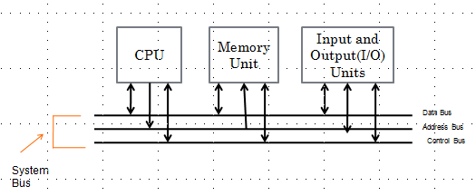
INTERCONNECTIONS of UNITS via Bus
Both processor and memory units hold a bi-directional relationship with the control and data bus.
In case of an address bus, the communication with processor and memory is unidirectional.
Processor provides location of data (stored in the register) to be fetched from the memory to the address bus and the data carries the required data to the processor.
I/O devices have a bi-directional relationship with the system bus.

Slide 9
Bus Structure & Why We Need It
A bus is a communication pathway that allows the CPU, memory, and input/output (I/O) devices to transfer data between each other.
Problem: All devices connected to the bus do NOT work at the same speed.
Very slow: keyboard, printer
Medium-fast: optical disk
Very fast: CPU and RAM
Imagine CPU (very fast) trying to communicate with a keyboard (very slow).
If both use the same bus directly:
    ➡ The CPU would spend a lot of time waiting
    ➡ System performance drops
How to solve???

Slide 10
Bus Structure & Why We Need It
How to Solve:
Approach 1: Buffer Registers
  Devices get buffer registers—small temporary storage inside the device.
  How it helps:
    When transferring data, the buffer temporarily holds the information.
    The CPU doesn’t have to wait for the device to finish its slow operation.
    It can drop the data in the buffer and continue its work.
    This speeds up communication with slow devices.

Slide 11
Bus Structure & Why Needed
How to Solve:
Approach 2: Two-Bus Structure
To avoid mixing very fast and very slow devices on the same bus, the system splits the bus into two:
  High-Performance Bus
    Connects CPU and main memory
    Handles high-speed data transfer
  Low-Performance Bus
    Connects slow devices like keyboard, printer, mouse
    Works at slower speed
  Bridge
    A special hardware component
    Connects the two buses
    Moves data from fast bus ↔ slow bus
  Why this is useful:
    CPU and memory can communicate at full speed
    Slow devices do not slow down the whole system
    Bus congestion is reduced
    Overall performance improves

Slide 12
Processing of Information
The bus is common to all the units in the computer. Before sending some information on the bus, a unit should verify whether the bus is free or occupied with some communication started by some other unit.
CPU is the bus master in a computer, which decides who should control the bus when more than one unit wants the bus at the same time.
An unit who needs the bus makes a request to the CPU and waits sanction. Till the CPU issues sanction, the requesting unit does not attempt to use the bus.

Slide 13
Control Unit
Operation of a computer can be summarized as:
  Accepts information from the input units (Input unit).
  Stores the information (Memory).
  Processes the information (ALU).
  Provides processed results through the output units (Output unit).
Operations of Input unit, Memory, ALU and Output unit are coordinated by Control unit.
Instructions control “what” operations take place (e.g. data transfer, processing).
Control unit generates timing signals which determines “when” a particular operation takes place.

Slide 14
Control Signals
The READ signal is a signal on the control bus which the microprocessor asserts when it is ready to read data from memory or I/O device.
When READ signal is asserted the memory subsystem places the instruction code be fetched on to the computer system’s data bus. The microprocessor then inputs the data from the bus and stores its internal register.
READ signal causes the memory to read the data, the WRITE operation causes the memory to store the data

Slide 15
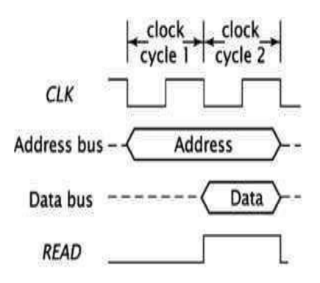
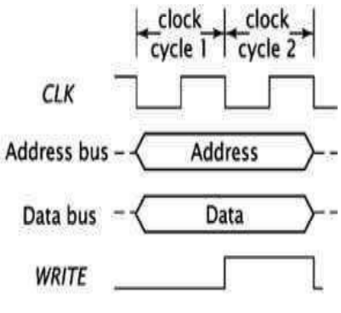
Timing Diagram Read/write Operation
Clock cycle 1:
  Address is placed on the address bus.
  READ signal is activated.
  Memory starts fetching the data.
Clock cycle 2:
  Memory outputs the data onto the data bus.
  Data is now available to be read by the processor.
Clock cycle 1:
Address is placed on the address bus.
Data is placed on the data bus.
WRITE signal goes high (active), initiating the write operation.
Memory writes the data to the specified address.
Clock cycle 2:
WRITE signal may still be asserted (depending on timing), but the write operation is typically complete by the end of cycle 1.
Data remains on the bus (optional hold), but is no longer required for the write.

Slide 16
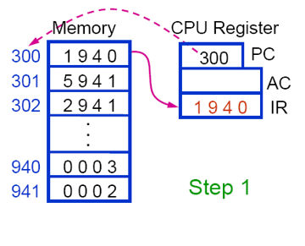
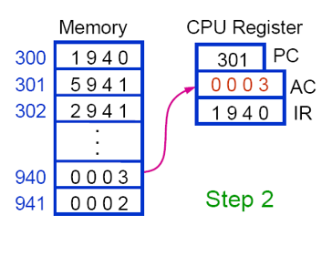
3+2
The PC = 300, meaning the next instruction is at memory address 300.
CPU goes to memory location 300 and fetches 1940.
This fetched value 1940 is put into the IR (Instruction Register).
The PC is increased to 301 (pointing to the next instruction).
What 1940 means: Load AC from memory location 940
The instruction 1940 says: Load AC ← Memory[940]
CPU goes to memory location 940.
Memory[940] = 0003
So AC is loaded with 0003.
Right Now:
  AC = 3
  PC = 301
  IR = 1940

Slide 17
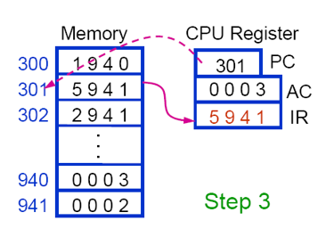
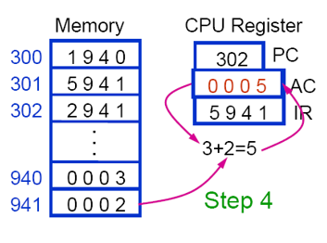
3+2
PC = 301, so CPU fetches memory[301].
Memory[301] = 5941
This is stored in the IR.
PC increments to 302.
5941 is the next instruction. Its meaning: Add the value from memory location 941 to the AC
CPU reads Memory[941].
Memory[941] = 0002
AC currently has 0003
So CPU performs: 3 + 2 = 5
AC becomes 0005
Right Now:
  AC = 5
  IR = 5941
  PC = 302

Slide 18
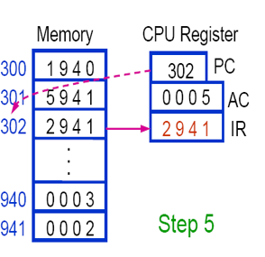
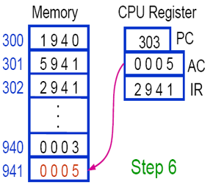
3+2
The PC = 302, so the CPU must fetch the next instruction from memory location 302.
Memory[302] contains: 2941
CPU copies 2941 into the IR (Instruction Register).
PC increments to 303 to point to the next instruction.
AC remains 0005 from the previous calculation.
So after Step 5:
  PC = 303
  IR = 2941
  AC = 0005
2941 is the instruction that will now be executed which is Store AC into Memory[941]
AC currently contains 0005
The instruction says: Store AC into Memory[941]
So the CPU writes 0005 into Memory[941]

Slide 19
32-bit vs. 64-bit: An Architectural Guide
What "32-bit" or "64-bit" Means:
  It's the amount of data the CPU can process in a single operation.
  Think of it as the size of the CPU's internal "data buckets" (registers).
Direct Consequences:
  Memory Address Space: The total amount of RAM the CPU can use.
  Data Path Width: The size of the "highway" for data moving in and out of the CPU.
  Computational Power: The size of the numbers it can work with natively.

Slide 20
32-bit vs. 64-bit: An Architectural Guide
Key Difference 1: Memory Support
32-bit Processor:
  Can access a maximum of 2³² memory addresses.
  This equals 4 GB of RAM (with ~3.5 GB typically usable).
  This is a hard ceiling.
64-bit Processor:
  Can access a theoretical 2⁶⁴ addresses—an astronomical amount.
  Practically supports 128 GB, 256 GB, or more RAM.
  This removes the biggest limitation of 32-bit systems.

Slide 21
32-bit vs. 64-bit: An Architectural Guide
Key Difference 2: The Bus Architecture
Data Bus:
  32-bit: 32 bits wide. Transfers 4 bytes of data per cycle to/from RAM.
  64-bit: 64 bits wide. Transfers 8 bytes of data per cycle.
Address Bus:
  32-bit: 32 bits wide, limiting addresses.
  64-bit: Wider (e.g., 48 bits), enabling massive memory support.

Slide 22
32-bit vs. 64-bit: An Architectural Guide
The Performance Myth: It's Not a Simple 2x Boost
Reality: Performance gains are highly application-dependent.
Heavy Lifter Apps Get a Major Boost:
  Scientific computing, video editing, 3D rendering.
  Why? They use large numbers and massive datasets that benefit from the wider data path and vast RAM.
Everyday Tasks See Little Change:
  Web browsing, word processing.
  Why? They are not limited by the CPU's data width or large amounts of RAM. Their performance is often dictated by storage (SSD/HDD) speed.

Slide 23
32-bit vs. 64-bit: An Architectural Guide
Software & Hardware Compatibility
One-Way Compatibility:
  A 64-bit system can run both 64-bit and 32-bit applications (via a compatibility layer).
  A 32-bit system can only run 32-bit software and cannot run 64-bit programs.
Hardware Requirement:
  You cannot "upgrade" a 32-bit CPU to 64-bit; it is a physical hardware design.
  64-bit operating systems require all hardware drivers to be 64-bit.

Slide 24
32-bit vs. 64-bit: An Architectural Guide
Which One is Better?
64-bit is the unequivocal standard and better choice today.
Choose 64-bit if you:
  Need more than 4GB of RAM.
  Use a modern OS (Windows 10/11, macOS, Linux).
  Run demanding applications (games, editing software, VMs).
32-bit is now largely obsolete, reserved only for very old hardware or specific legacy industrial systems.

Slide 25
Software Concepts

Slide 26
Software
Software refers to a collection of programs
Program is a sequence of instructions written in a language that can be understood by a computer
Software package is a group of programs that solve a specific problem or perform a specific type of job
HW and Software Relationship:
Both hardware and software are necessary for a computer to do useful job. They are complementary to each other
Same hardware can be loaded with different software to make a computer system perform different types of jobs
Except for upgrades, hardware is normally a onetime expense, whereas software is a continuing expense
Upgrades refer to renewing or changing components like increasing the main memory, or hard disk capacities, or adding speakers, modems, etc.

Slide 27
Types of SW
System software are designed to control the operation and extend the processing capability of a computer system
    Make the operation of a computer system more effective and efficient
    Help hardware components work together and provide support for the development and execution of application software
    Programs included in a system software package are called system programs and programmers who prepare them are called system programmers
    Examples of system software are operating systems, programming language translators, utility programs, and communications software
Application software are designed to solve a specific problem or to do a specific task
    Programs included in an application software package are called application programs and the programmers who prepare them are called application programmers
    Examples of application software are word processing, inventory management, preparation of tax returns, banking, etc.

Slide 28
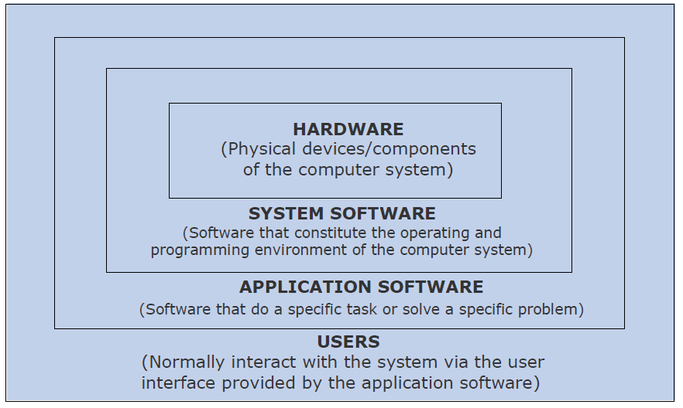
Logical System Architecture
Relationship among hardware, system software, application software, and users of a computer system.

Slide 29
System Software
System software performs several critical functions:
Resource Management: Manages the computer's memory, processing power (CPU), and storage.
Hardware Abstraction: Provides a simple, consistent way for applications to interact with complex hardware (e.g., through drivers).
User Interface: Provides an interface (like a Command Line or GUI) for users to interact with the computer.
Security & Protection: Controls access to system resources and protects against unauthorized use.
Job Scheduling: Decides which process gets the CPU and when.

Slide 30
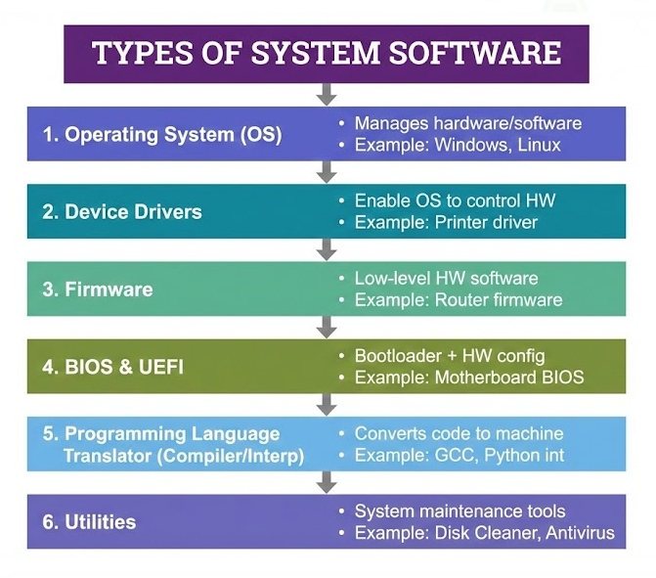
System Software - Types

Slide 31
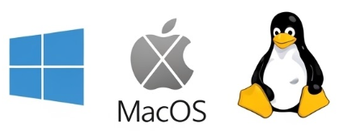
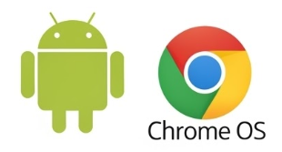
System Software - Operating System (OS)
The Master Controller: The most important system software that manages all other programs on a computer.
Key Functions of an OS:
  Process Management: Manages the execution of programs (processes).
  Memory Management: Allocates and deallocates memory space for programs.
  File System Management: Manages files and directories on storage devices.
  Device Management: Controls all Input/Output devices.
  Security: Provides user authentication and data protection.
Examples: Windows, macOS, Linux, Android, iOS.

Slide 32
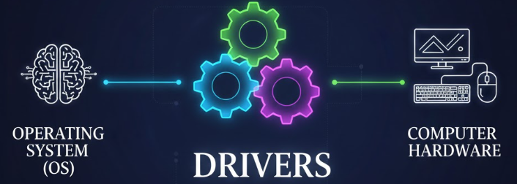
System Software - Device Drivers
The Hardware Translators: Specialized programs that allow the operating system to communicate with a specific hardware device.
Why are they needed? The OS doesn't know how to control every model of printer, graphics card, or scanner. The driver acts as a translator.
Function: Converts general OS commands into device-specific commands that the hardware understands.
Examples: Printer Driver, Graphics Card Driver, Sound Card Driver.

Slide 33
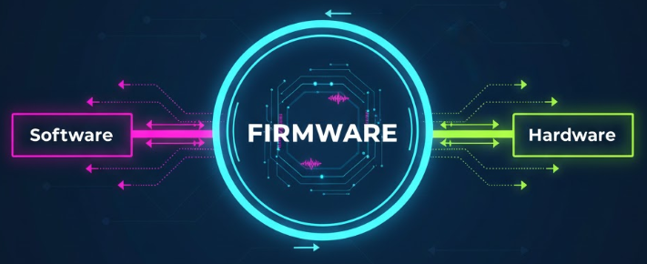
System Software - Firmware
"Software in Hardware": Software that is permanently stored on a hardware device (in ROM, PROM, or EPROM).
Function: Provides the low-level control for the device. It is the first software to run when a device is powered on.
Key Example: BIOS (Basic Input/Output System)
  Located on the computer's motherboard.
  Performs the Power-On Self-Test (POST).
  Initializes and identifies system hardware (CPU, RAM, etc.).
  Bootstraps the operating system from the hard drive.
Firmware is the "bridge" between the raw hardware and the higher-level software like the OS

Slide 34
System Software - Language Translators
The Code Converters: Software that converts code written by a programmer into machine code (binary 1s and 0s) that the computer can execute.
Types:
  Compiler: Translates the entire high-level program (source code) into machine code in one go, creating an executable file. (e.g., C, C++)
  Interpreter: Translates and executes the program line-by-line. (e.g., Python, JavaScript)
  Assembler: Translates assembly language code (low-level) into machine code.

Slide 35
System Software – Why important
Efficiency: Ensures hardware resources are used effectively.
Ease of Use: Hides the complexity of hardware operations from the user.
Platform for Applications: Without an OS, you cannot run Word, games, or a web browser.
Hardware Compatibility: Allows a wide range of hardware to work with a single OS through drivers.
System Stability & Security: Protects the system from crashes and unauthorized access.

Slide 36
Application Software
Key Characteristics of Application Software:
User-Centric: Designed for a specific user purpose or task.
High-Level: Written in high-level programming languages for ease of development and use.
Interactive: Features a user-friendly interface (GUI, menus, etc.).
Dependent: Requires system software (especially an OS) to function.
Varied: Comes in a vast range of types for different needs (productivity, creativity, etc.).

Slide 37
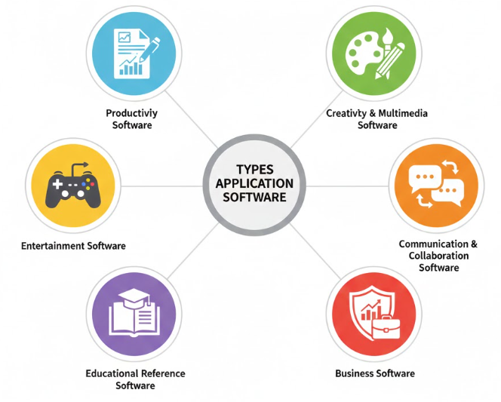
System Software - Types
Enable users to create, edit, and manipulate visual, audio, and video content.
To improve individual efficiency and organization.
Video games, media players (VLC, Spotify), streaming apps (Netflix).
Facilitate communication and teamwork between people.
Language learning apps (Duolingo), tutoring software, Digital encyclopedias (Wikipedia app).
Manage and automate business operations and processes for organizations.

Slide 38
Application Software – Why important
Productivity & Efficiency: Automates and simplifies complex tasks.
Problem Solving: Provides tools for specific challenges (e.g., accounting, design).
Connectivity: Connects people across the globe.
Creativity & Entertainment: Enables content creation and provides leisure activities.
Business Operation: The backbone of modern commerce and industry.

